Slide 1
Quality of Service
Outline
  Realtime Applications
  Integrated Services
  Differentiated Services

Slide 2
Realtime Applications
Require “deliver on time” assurances
  must come from inside the network
Example application (audio)
  sample voice once every 125us
  each sample has a playback time
  packets experience variable delay in network
  add constant factor to playback time: playback point
Sampler
Microphone
,
Buffer
A D
,
converter
D A
Speaker

Slide 3
Playback Buffer
Packet
arrival
Packet
generation
Playback
Sequence number
Network
Buffer
delay
T
ime

Slide 4
Example Distribution of Delays
3
90%
97%
98%
99%
2
Packets (%)
1
50
100
150
200
Delay (milliseconds)

Slide 5
Taxonomy
Applications
Real time
Elastic
T
Interactive
Interactive
Asynchronous
olerant
Intolerant
bulk
Adaptive
Nonadaptive
Rate-adaptive
Nonadaptive
Delay-
Rate-
adaptive
adaptive

Slide 6
Integrated Services
Service Classes
  guaranteed
  controlled-load
Mechanisms
  signalling protocol
  admission control
  policing
  packet scheduling

Slide 7
Flowspec
Rspec: describes service requested from network
  controlled-load: none
  guaranteed: delay target
Tspec: describes flow’s traffic characteristics
  average bandwidth + burstiness: token bucket filter
  token rate r
  bucket depth B
  must have a token to send a byte
  must have n tokens to send n bytes
  start with no tokens
  accumulate tokens at rate of r per second
  can accumulate no more than B tokens

Slide 8
Per-Router Mechanisms
Admission Control
  decide if a new flow can be supported
  answer depends on service class
  not the same as policing
Packet Processing
  classification: associate each packet with the appropriate reservation
  scheduling: manage queues so each packet receives the requested service

Slide 9
Reservation Protocol
Called signaling in ATM
Proposed Internet standard: RSVP
Consistent with robustness of today’s connectionless model
Uses soft state (refresh periodically)
Designed to support multicast
Receiver-oriented
Two messages: PATH and RESV
Source transmits PATH messages every 30 seconds
Destination responds with RESV message
Merge requirements in case of multicast
Can specify number of speakers

Slide 10
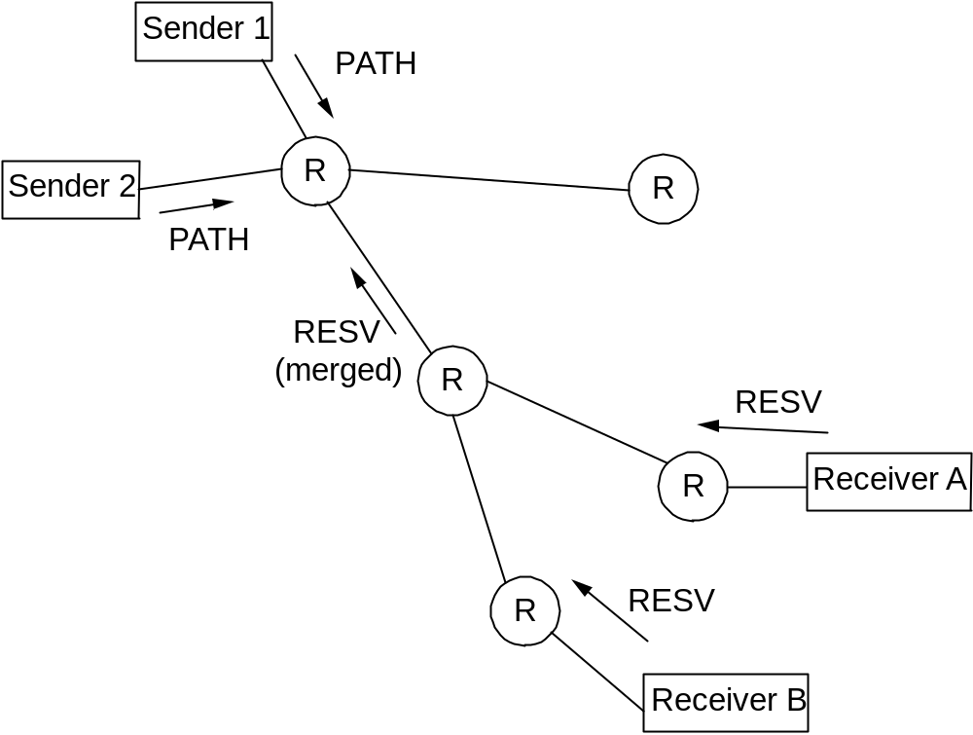
RSVP Example

Slide 11
RSVP versus ATM (Q.2931)
RSVP
  receiver generates reservation
  soft state (refresh/timeout)
  separate from route establishment
  QoS can change dynamically
  receiver heterogeneity
ATM
  sender generates connection request
  hard state (explicit delete)
  concurrent with route establishment
  QoS is static for life of connection
  uniform QoS to all receivers

Slide 12
Differentiated Services
Problem with IntServ: scalability
Idea: support two classes of packets
  premium
  best-effort
Mechanisms
  packets: ‘in’ and ‘out’ bit
  edge routers: tag packets
  core routers: RIO (RED with In and Out)
P(drop)
1.0
MaxP
A
vgLen
Min
out
Min
in
Max
out
Max
in

